Slide 1
Action Research on Enhancing Academic Excellence in Science through the Use of Collaborative Learning Method in Gamodubu Primary School
By Kaone Bakokonyane
Tiro Mokgoare

Slide 2
Collaborative Learning Method
Collaborative learning is a method that transforms the traditional teacher focused room into a student learning centered room
The student work together to help each other understand the content, solve problems, with the teacher working as a facilitator (McNiff, 2002)
In collaborative learning there is a greater level of responsibility and autonomy of students, because the group decides how to perform the task, the procedures they carry out and the division of labour (Valtonen, 2011)

Slide 3
Upper Primary Science Syllabus
Upper primary science syllabus is developed to meet the requirements of RNPE 1994 to develop science process skills through exploring the environment and explaining scientific events and phenomena (Curriculum Development Division, 2005)
It is used as a problem solving tool to combat socio-economic problem(CDD, 2005)
It is also used to develop critical thinking skills in learners (CDD, 2005)
It is given 3 hours per week
It covers topics like science and society, nature and the universe, matter and energy, force and motion, electricity and magnetism

Slide 4
Background of the study on the subject
The study focused on science academic performance of students who were doing standard 6A in Gamodubu Primary School in 2018
The class was made up of 16 boys and 16 girls total of 32 learners
Science was poorly performed in this class,
Academic performance in ABC passes were as follows; January, 22.6%, February, 38.7%, End of term 1 45,2 %, May, 59.3% and of Term 2, 31.2%
Questionnaires were administered to students before the study and 1 out of 32 had interest and 31 out of 32 had no interest in the Subject
Students revealed that they had little or no interest in the subject

Slide 5
Background of the study on the method of teaching
Teacher centered approach, was mostly used where the teacher did most of the teaching and learners answer questions
The science syllabus methodology advocates for the teacher to be the facilitator and learners to be both learners and teachers ( CDD, 2005)
It advocates that learners should be accountable and responsible learners who take an active part in their learning environment
The syllabus also wants teachers to recognize different levels of achievement from topic tests, monthly tests and end of term tests
It also calls for implementation of recommendation 18 (a) which calls for the use of English as a medium of instruction from standard 2 onwards and within the school environment (Bakwena-Permanent Secretary, 2005).

Slide 6
Problem identification
Science was poorly performed in standard 6 A
Reasons being that learners had no interest in the subject
The teacher used the wrong teaching method for the subject
Therefore an Action research was conducted to find out if collaborative learning method can improve academic performance in Science
This was to be done because if it cannot be done the RNPE (1994) prospects of coming up with a critical thinking learner who can combat the socio-economic problems cannot be achieved

Slide 7
Purpose of the study
To investigate whether collaborative learning method can improve academic performance of science in standard 6A class in Gamodubu Primary School

Slide 8
Significance of the study
This study could enable the researcher to make recommendations to the teachers, education officers and assessment officers on how collaborative learning can improve academic performance
The study could also make recommendation for further research on the method to other subjects

Slide 9
Focus of the study
The study focused on STD 6A class in science subject
The study tracked the results of science from term 1and term 2 when collaborative learning method was not used and end of month tests and end of term tests when the method was used

Slide 10
Theoretical frame work used
The study used the theory of Action by Argyris and Schon (1978) which argued that the theories of action must produce solutions to problems

Slide 11
Research framework methodology
The study used the Design Based Intervention Research framework
The framework developed the collaborative learning method which catered for both classroom learning and implementation through systematic inquiry (Penuel et-al, 2011)
The framework developed, tested and refined the collaborative learning method
The researcher gathered a lot of literature on collaborative learning method and designed the one which can be suitable for the class
The researcher shared the method with research committee
The method was also shared with the learners

Slide 12
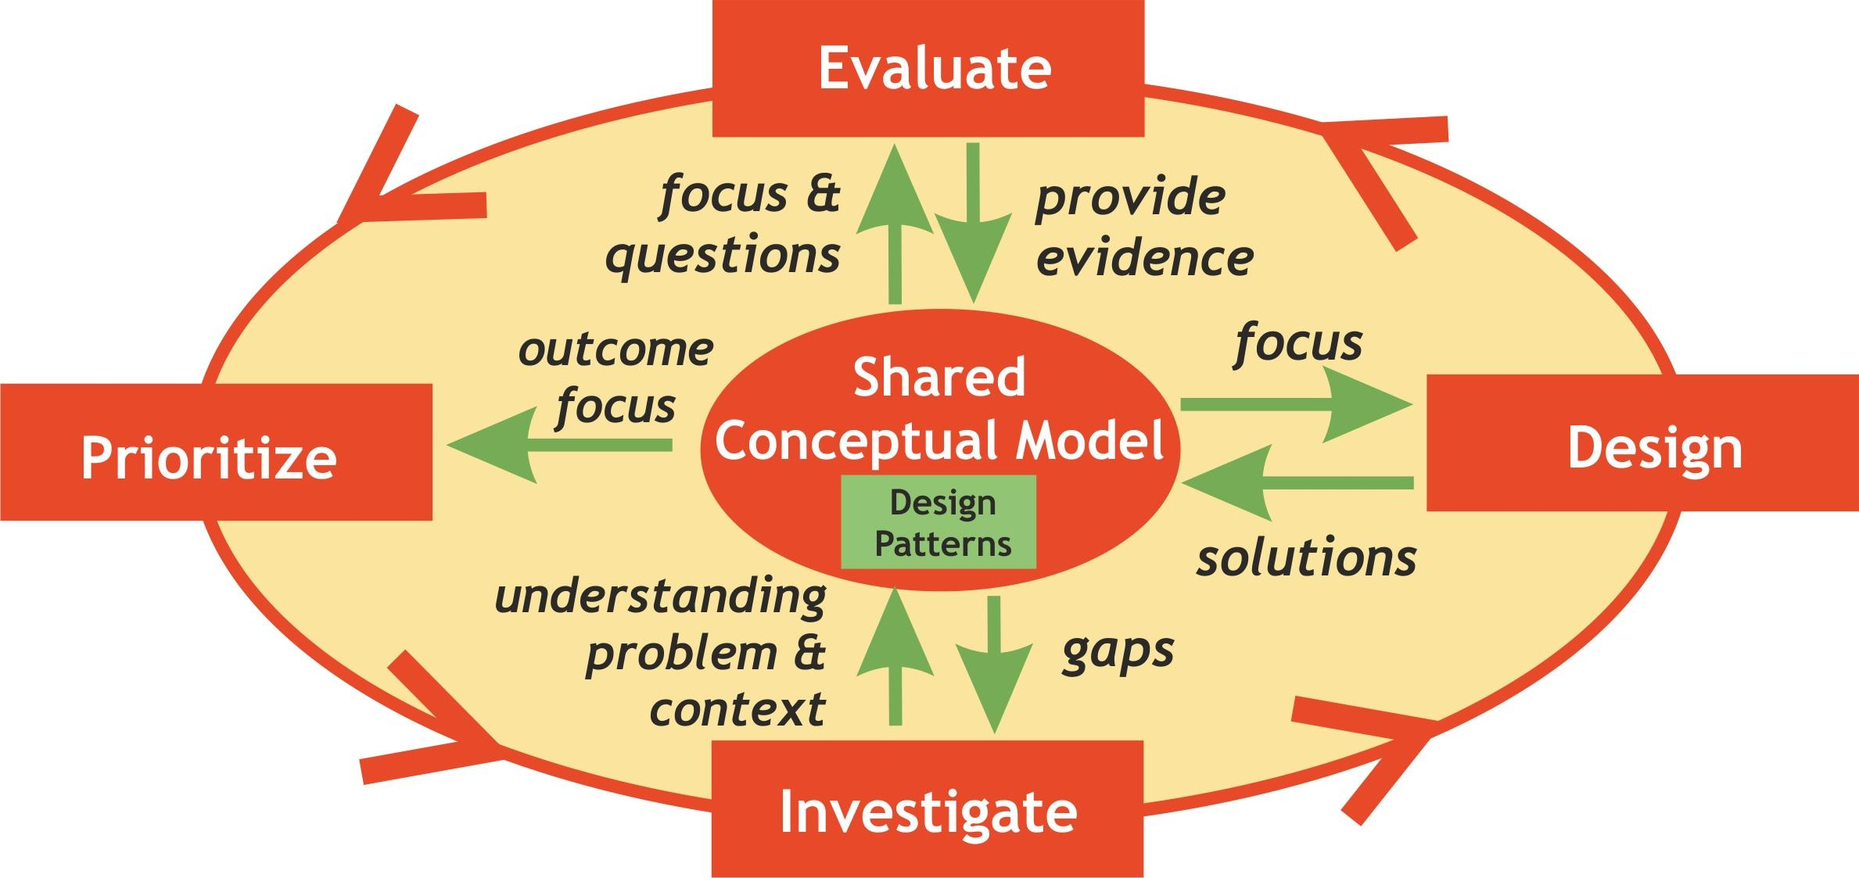
Design Based Intervention Research

Slide 13
Research Framework methodology
The CLMS project entailed a monthly circle in which the researcher, planned the method, implemented the method , do testing to check if there was improvement in academic performance.
The researcher used questionnaires, rubrics and interview as a follow up and gave feedback to the research committee to make actionable recommendations regarding how the strategies can be adjusted in the next cycle
The framework consisted of curriculum materials, learners, teacher, coach, research committee and school leaders.

Slide 14
Classroom based design-research methodology
The design cycle was at the timescale of a lesson I day instruction (Cobb et-al, 2003)
The class was divided into mixed ability groups of 6 to cater for 3 topics and each group had 3 objectives to work on
Each group discussed the topics , did lesson plan and taught other students
The lessons were video recorded and rubric was used to test for social skills
After every topic there was a topic test, which was recorded and analyzed

Slide 15
Classroom based design research

Slide 16
Presentation of academic results after the method
PERIOD | TOTAL | ABC | DE
AUGUST | 32 | 68.8 | 31.2
TERM 3 2018 (covered topics only) | 32 | 61.2 | 38.8
TERM 1 2019 | 31 | 64.5 | 35.5

Slide 17
Benefits on learning through collaborative learning method from questionnaires
Check point | No | %
Helped understanding | 30 | 96.8
Pooled knowledge and expertise | 28 | 90.3
Got helpful feedback | 29 | 93.5
Stimulated thinking | 28 | 90.3

Slide 18
Benefits focusing on social and emotional aspects from questionnaires
Check point | No | %
More relaxed atmosphere | 30 | 96.8
Made problem solving easier | 27 | 87.1
It was fun | 29 | 93.5
Greater responsibility for me and the group | 28 | 90.3
Made new friends | 30 | 96.8

Slide 19
Rubric results used during lessons
Group | No | Worked as a group |  | Shared responsibilities |  | Made substantial decisions together |  | Worked independently
A | 5 | 4 | 80 | 5 | 100 | 4 | 80 | 5 | 100
B | 6 | 5 | 83.3 | 5 | 83.3 | 5 | 83.3 | 6 | 100
C | 5 | 4 | 80 | 5 | 100 | 5 | 100 | 4 | 80
D | 5 | 5 | 100 | 4 | 80 | 5 | 100 | 4 | 80
E | 5 | 5 | 100 | 5 | 100 | 5 | 100 | 4 | 80
F | 6 | 5 | 83.3 | 5 | 83.3 | 6 | 100 | 5 | 83.3

Slide 20
Findings of the study
The method has improved academic performance of science from 22.6 % January end of Month std 6 2018 test to 64.5% End of Term 1 2019 Examination.
Students also developed a lot of interest in Science
The method has promoted active and creative learning
It has promoted a high degree of positive attitudes towards peer teaching and learning

Slide 21
Findings of the study-Advantages of the method
Students were developed academically and non academically
Academically students were able to use information provided by their peers, promote accurate communication, were able to be influenced by the ideas of others, more confident in their ideas and expressing them
Non academically, it has promoted pro-social behaviors, integration of students with lower performance level, high acceptance and peer support, increase self esteem, decreasing fear of failure

Slide 22
Findings of the study-Limitations of the method
The method took a longer time than the traditional method as the teacher had to build social skills which was the the integral component
It reduced the pace of work for students
It integrated new assessment methodologies the qualitative assessments while the educational managers require quantitative data which are the performance rates

Slide 23
Recommendations
The method to be rolled out to other subjects
The method to be used in revision
The method to be rolled out to other schools

Slide 24
Thank you for listening to my presentation

